Slide 1
19CSE357 -Big Data Analytics
Dr. R. Karthi
Associate Professor
Dept of CSE

Slide 2
Course Objectives
To provide knowledge about Big data technologies and its tools.
Learn to implement and work on techniques to handle large volume of data in parallel and distributed environments.
Retrieval and analysis of unstructured data using NOSQL databases.

Slide 3
Course Outline
Understand the basics of Big data.
Understand Hadoop architecture and distributed processing.
Learn to implement map-reduce programs for big data.
Understand and apply Big data techniques for various applications. (Hive, Pig, MongoDB and Cassandra)
Course – Lab Based Course (3 Credits)
2 hrs. theory + 2 hrs. lab per week.
Laptop with internet connectivity required for Theory and Lab hrs.
Enthusiasm to explore and learn new skills.
Lab slots are used to demonstrate and have hand on experience on each platform/tool.

Slide 4
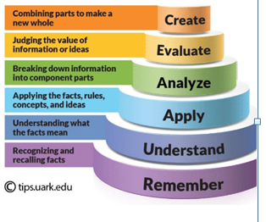
Course Outcomes
 | Course Outcome | Bloom’s Taxonomy Level
CO 1 | Understand fundamental concepts of Big Data and its technologies | L2
CO 2 | Apply concepts of Map Reduce framework for optimization. | L3
CO 3 | Analyze appropriate No SQL database techniques for storing and processing large volumes of structured and unstructured data. | L4
CO 4 | Apply data analytics solutions using Hadoop ecosystems | L3
CO 5 | Explore tools for machine learning and reporting | L4

Slide 5
Evaluation Pattern
Evaluation Component | Weightage
Mid Term Exam | 10 (Online Exam) + 10 (Viva)
Continuous assessment | 10 ( Theory) + 40 (Lab)
End Semester | 10 (Online Exam) + 20 (Viva)

Slide 6
Evaluation Pattern - Continuous Assessment
Evaluation Component | Weightage
Theory | Continuous Assessment (T)​ Quiz-1 - 3 Marks​ Quiz-2 - 3 Marks​ Quiz-3 - 4 Marks​
Lab | Continuous Assessment (L)​ Evaluation -1 - 10 Marks​ Evaluation -2 - 10 Marks​ Evaluation -3 - 10 Marks​ Case study - 10 Marks​

Slide 7
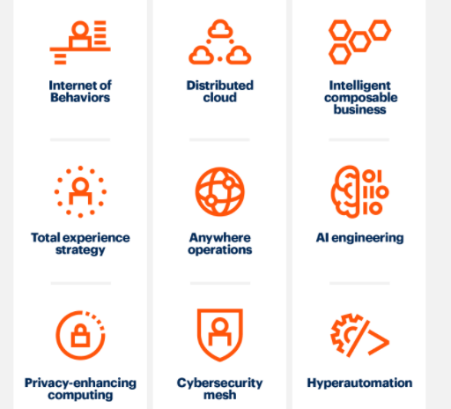
Gartner Top Strategic Technology Trends for 2021
https://www.gartner.com/smarterwithgartner/gartner-top-strategic-technology-trends-for-2021

Slide 8
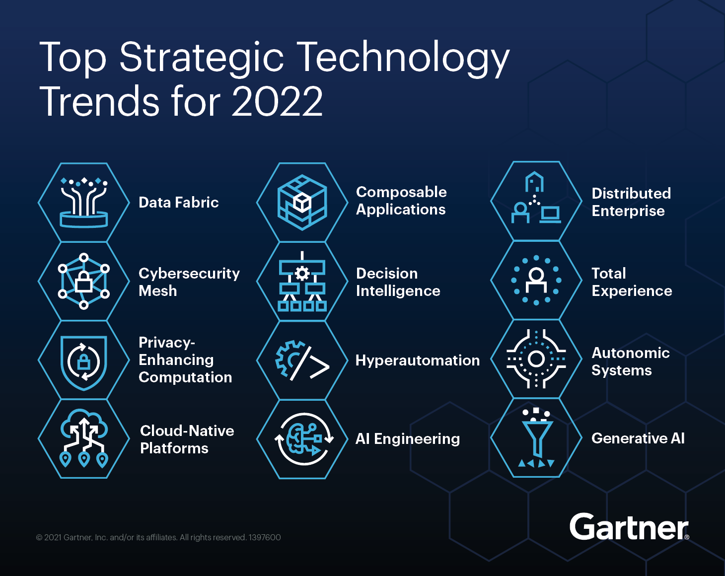
https://www.gartner.com/en/information-technology/insights/top-technology-trends

Slide 9
Thank you

